Slide 1

Interview Prep and Debrief/Close: Candidates

Slide 2

Who To Prep
Candidate
Client

Slide 3

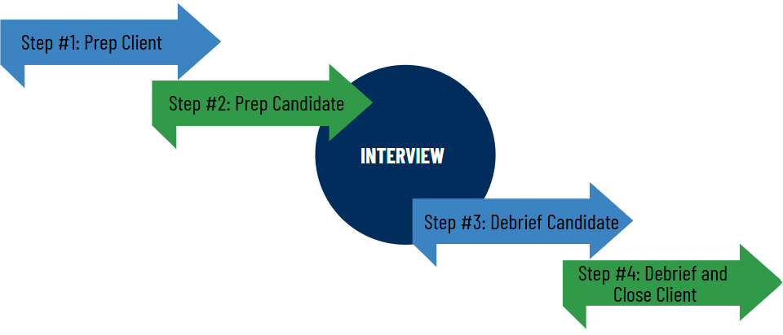
Timeline Of Events

Slide 4

Candidate Interview Prep
Prep and preclosing questions (more to come).
Details on who they are interviewing with (company, interviewers, culture)- use this time to SELL! (Sell them out first → then sell them in).
Insight on the client’s must haves and talk through their related experience.
General interview prep tips.
Reconfirm IV logistics and tell them about the confirmation email with resources and job description.
Confirm next steps:
If 2nd interview: “when are you specifically available”
If offer: “can we accept on your behalf” and “when can you start”
ALWAYS LEAVE THE CONVERSATION WITH A DEBRIEF FOLLOW UP TIME SET ON THE CALENDAR!

Slide 5
Good Probing Prep Questions
If remote: dig in! (Workspace, flexibility and expectations)
Talk me through challenging scenarios you have had at work and how you overcame them.
What will you do to stand out in this interview?
How do your skills align with this role and company?
Ask about any PTO or notice required from current role.
What is your biggest motivating factor in taking a new role?
Do you have any concerns with your ability to do the job?

Slide 6
Good Pre-Closing Questions
What else do you have in the mix?
Can we accept on your behalf?
On a Scale of 1-10 how interested are you in the role?
Is there a possibility for an extension/
counter offer?
How does this role rank with other potentials?
When can you start?
What excites you most about this opportunity?
Confirm Rate!

Slide 7
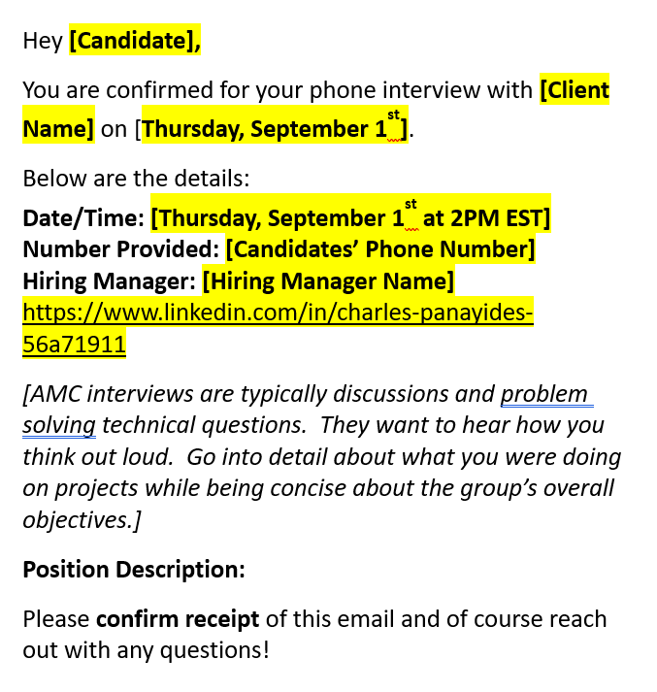

Confirmation Email
Notes:
MUST always have an interview confirmation email sent to the candidate. Best practice is for the recruiter to send and cc the AE but it is the AE’s responsibility to double check the info is correct.
Make sure to attached the formal job description and the IV prep documents.

Slide 8
Candidate Debrief
Ask open ended questions:
How long did the interview last?
How did they feel it went on a scale of 1-10?
What specific questions were asked?
What aspects of the IV went well?
Were there areas you didn’t feel confident?
Are you still interested in the role? Why or why not?
Did they mention next steps?
Re-ask pre-closing questions:
Will they accept?
Can we accept on their behalf
How does this rank now with opportunities?
When can they start?
Take notes and put them into JobDiva for future IV prep!
Set the expectation that the candidate is sending you a personalized, specifically tailored thank you note to relay to the hiring manager.

Slide 9
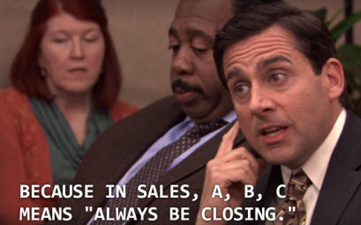
Closing Should Always Be At The Forefront
Closing starts in the first call with the candidate
→ Set YOUR expectations
Take great notes in initial discussion about their pain points and use them to reference back to the initial wants/needs
You have to know your candidate to sell them the role
Use the candidate debrief to identify the gaps and use that to sell
→ Use references, candidate thank you notes and testimonials
YOUR JOB AS A RECRUITER IS TO SELL THE ROLE NOT JUST BE PASSIVE.

Slide 10


